Slide 1

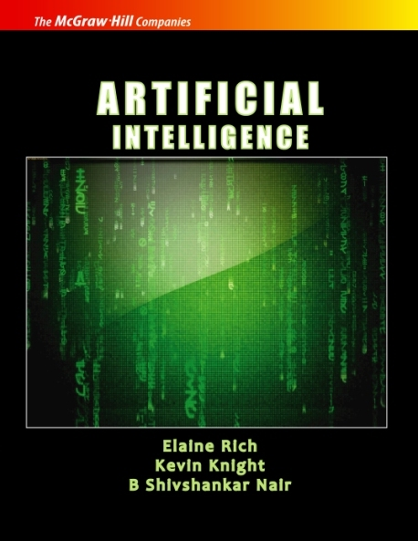
ARTIFICIAL INTELLIGENCE
Third Edition
Transparencies/Handouts
Chapter 5
Using Predicate Logic
PROPRIETARY MATERIAL. © 2009 The McGraw-Hill Companies, Inc. All rights reserved. No part of this PowerPoint slide may be displayed, reproduced or distributed in any form or by any means, without the prior written permission of the publisher, or used beyond the limited distribution to teachers and educators permitted by McGraw-Hill for their individual course preparation. If you are a student using this PowerPoint slide, you are using it without permission.
99

Slide 2
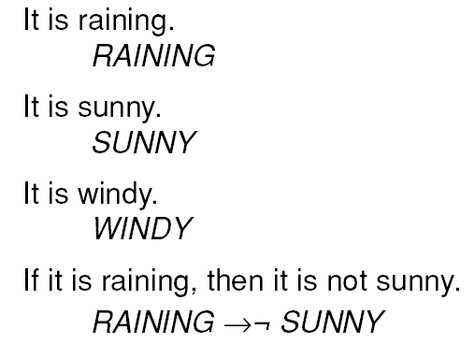
Some Simple Facts in
Propositional Logic
100

Slide 3
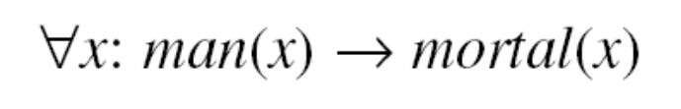
Limitations of Propositional Logic
Socrates is a man.
SOCRATESMAN
Plato is a man.
PLATOMAN
Better representations :
MAN(SOCRATES)
MAN(PLATO)
All men are mortal.
MORTALMAN
Better representation :
101

Slide 4
A Predicate Logic Example
Marcus was a man.
Marcus was a Pompeian.
All Pompeian were Romans.
Caesar was a ruler.
All Romans were either loyal to Caesar or
hated him.
Everyone is loyal to someone.
People only try to assassinate rulers they
are not loyal to.
Marcus tried to assassinate Caesar.
102

Slide 5
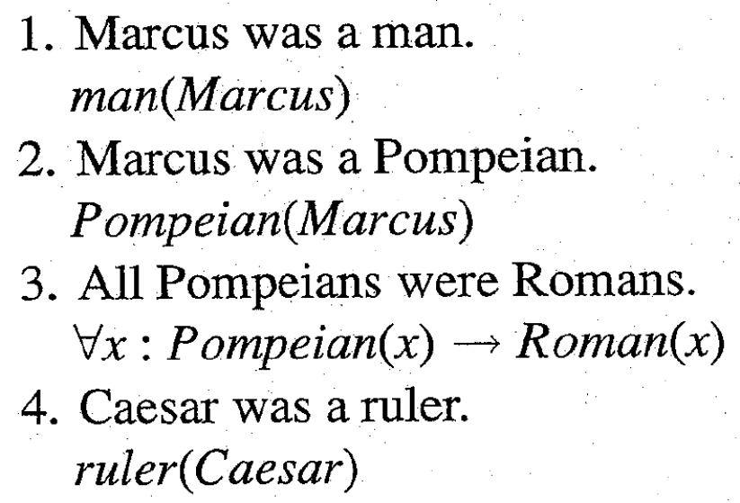
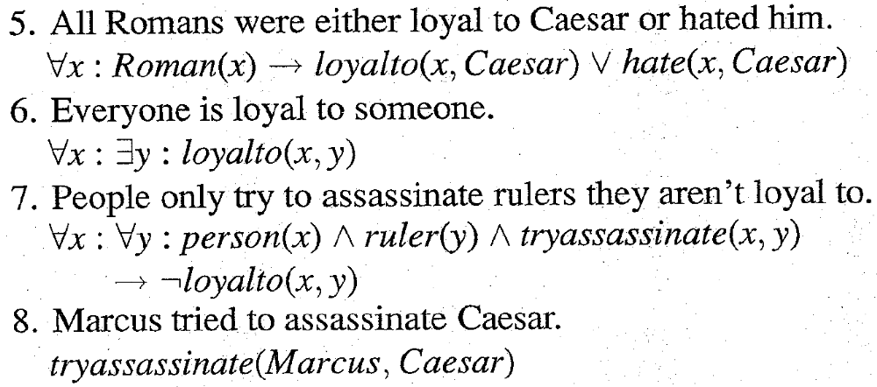
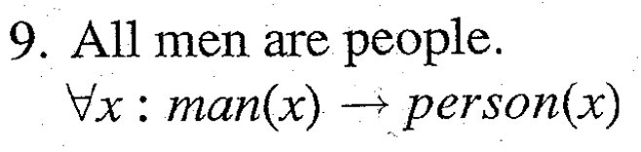
A Predicate Logic Example
103

Slide 6

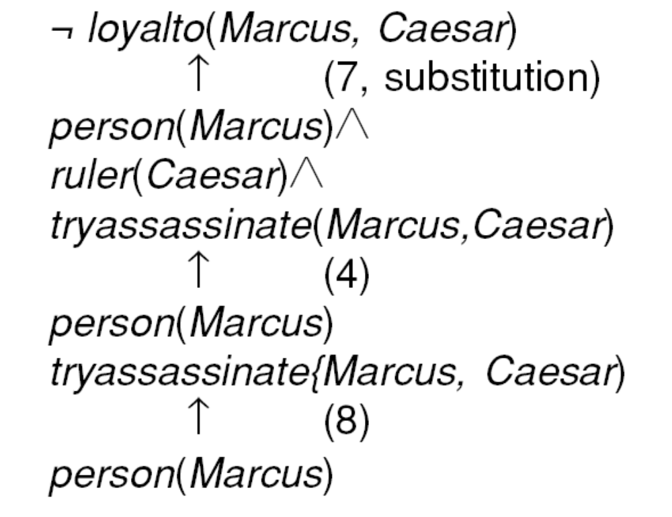





An Attempt to Prove
104

Slide 7
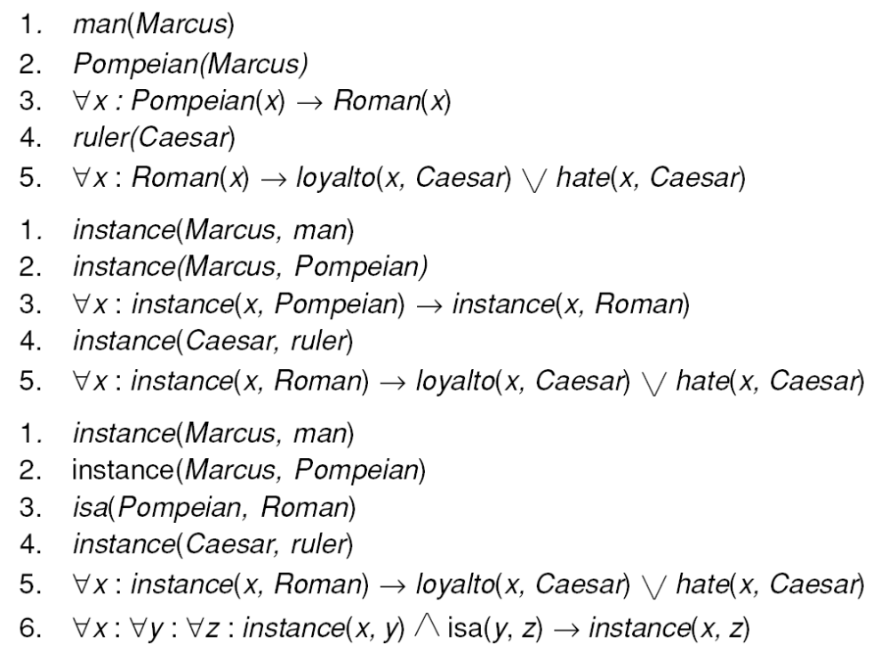
Three Ways of Representing
Class Membership
105

Slide 8
Another Predicate Logic Example
Marcus was a man.
Marcus was a Pompeian.
Marcus was born in 40 A.D.
All men are mortal.
All Pompeians died when the volcano erupted in 79 A.D.
No mortal lives longer than 150 years.
It is now 1991.
Alive means not dead.
If someone dies, then he is dead at all later times.
107

Slide 9
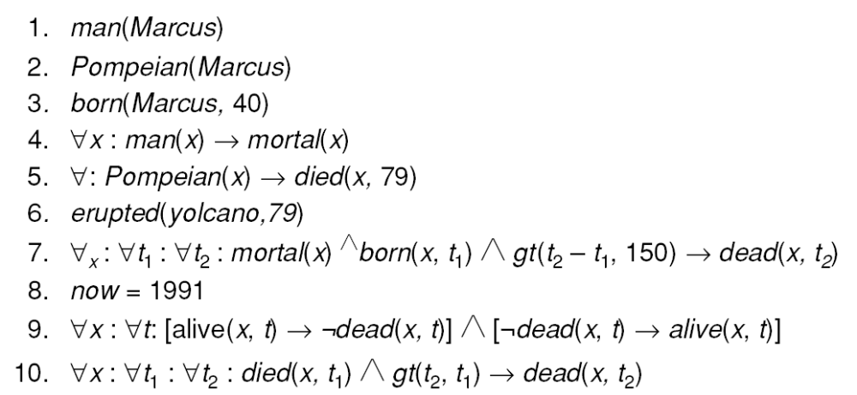
A Set of Facts about Marcus
108

Slide 10
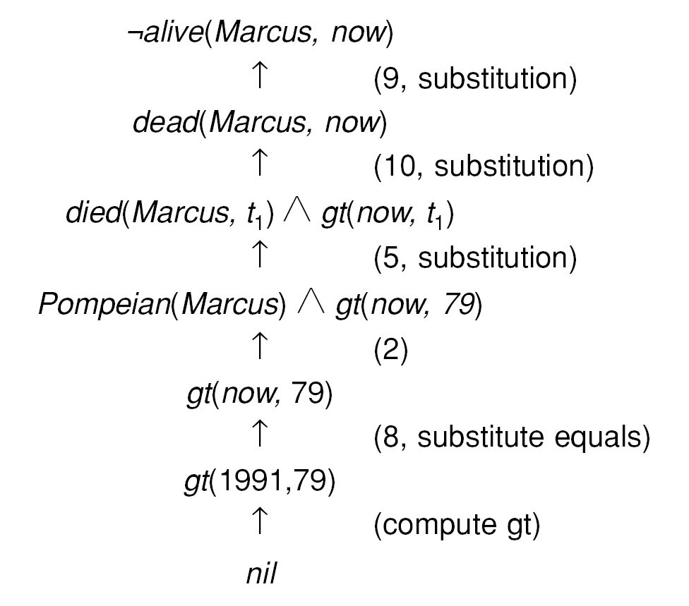
One Way of Proving That Marcus Is Dead
109

Slide 11
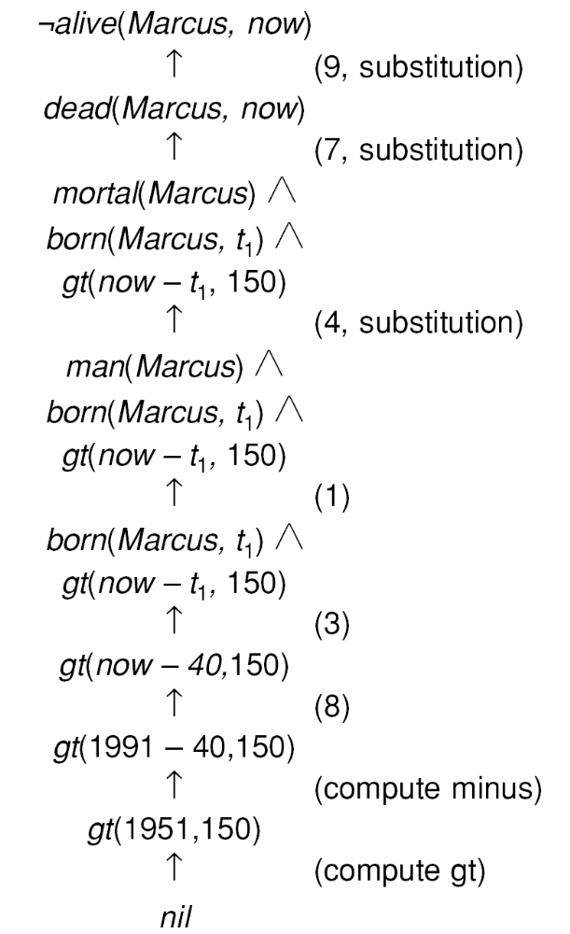
Another Way of Proving That Marcus Is Dead
110

Slide 12
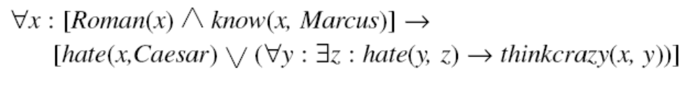


Conversion to Clause Form
Problem :
Solution :
 Flatten
 Separate out Quantifiers
Conjunctive Normal Form :
Clause Form :
 Conjunctive Normal Form
 No instances of
111

Slide 13
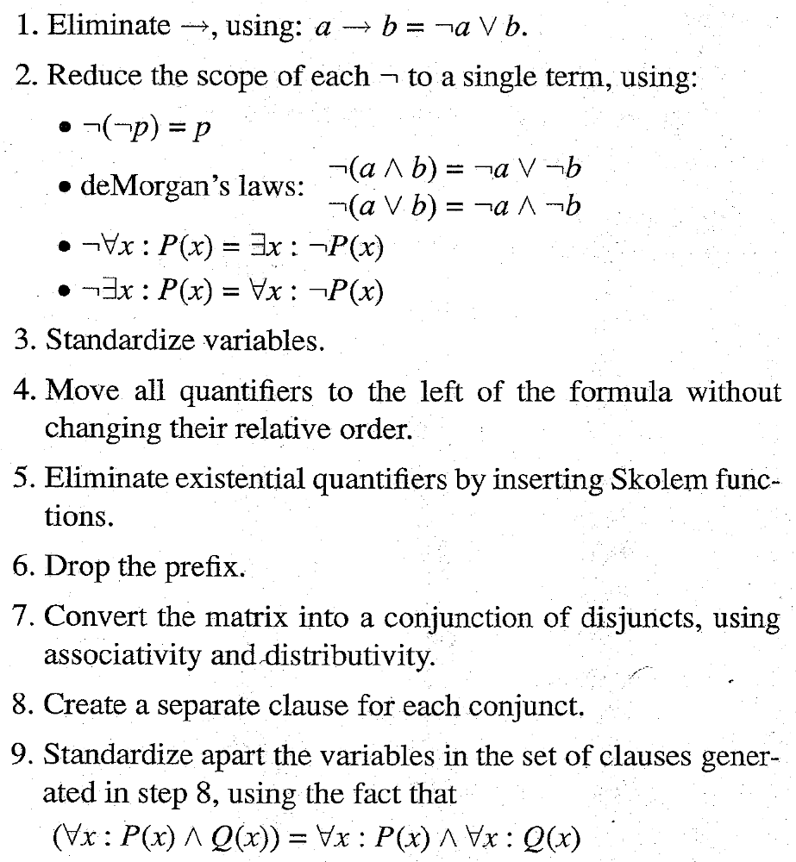
Algorithm : Convert to Clause Form
112

Slide 14
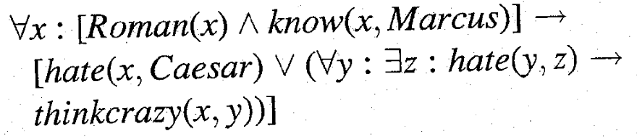
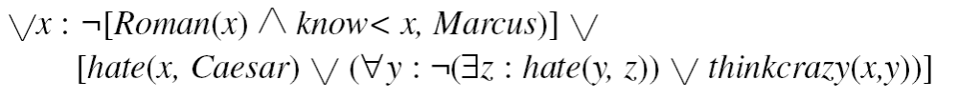
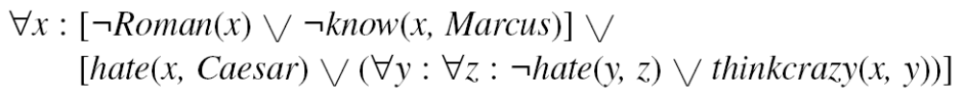



Examples of Conversion to Clause Form
Example :
1 Eliminate 
2 Reduce scope of
3 Standardize Variables.
113

Slide 15






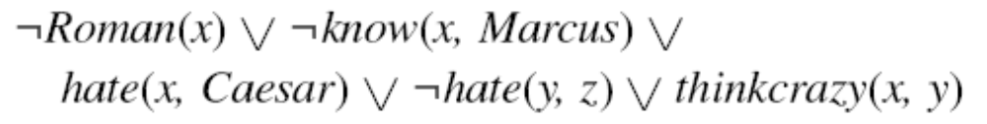
Examples of Conversion to Clause Form
4 Move quantifiers.
5 Eliminate existential quantifiers.
will be converted to
while
will be converted to
6 Drop the prefix.
7 Convert to a conjunction of disjuncts.
114

Slide 16
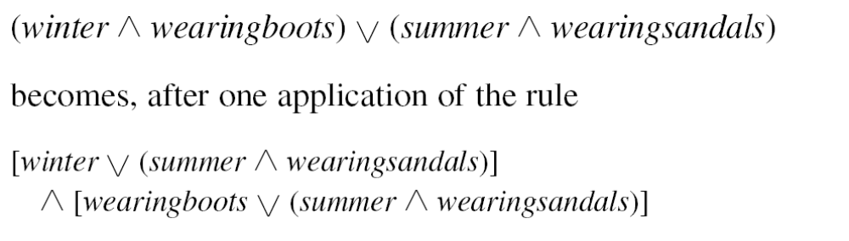
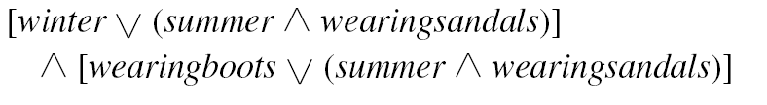
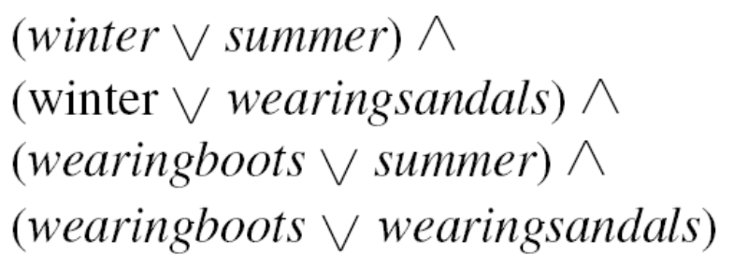
Examples of Conversion to Clause Form
The Formula
becomes
and then becomes
115

Slide 17
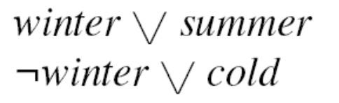

The Basis of Resolution
Given :
becomes
116

Slide 18
Herbrand’s Theorem
• To show that a set of clauses S is unsatisfiable, it is necessary to consider only interpretations over a particular set, called the Herbrand universe of S.
• A set of clauses S is unsatisfiable if and only if a finite subset of ground instances (in which all bound variables have had a value substituted for them) of S is unsatisfiable.
117

Slide 19
Algorithm : Propositional Resolution
Convert all the propositions of F to clause form.
2. Negate P and convert the result to clause form. Add it to the set of clauses obtained in step 1.
3. Repeat until either a contradiction is found or no progress can be made:
Select two clauses. Call these the parent clauses.
(b) Resolve them together. The resulting clause, called the resolvent, will be the disjunction of all of the literals of both of the parent clauses with the following exception: If there are any pairs of literals L and ¬L such that one of the parent clauses contains L and the other contains ¬L, then select one such pair and eliminate both L and ¬L from the resolvent.
(c) If the resolvent is the empty clause, then a contradiction has been found. If it is not, then add it to the set of clauses available to the procedure.
118

Slide 20
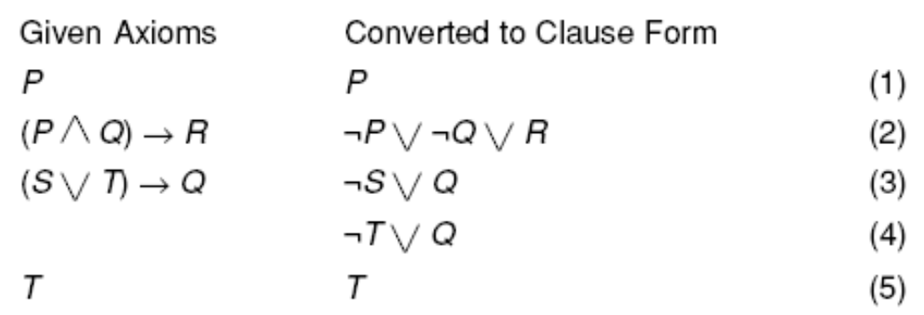
A Few Facts in Propositional Logic
119

Slide 21
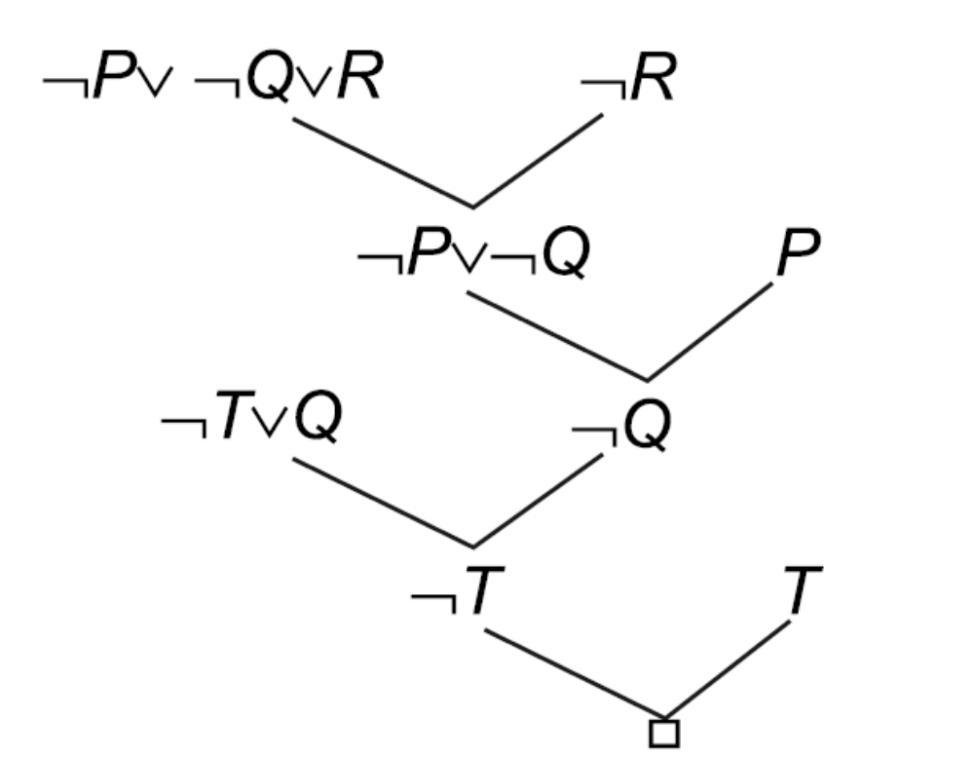
Resolution in Propositional Logic
120

Slide 22
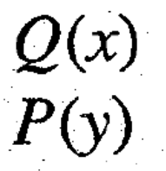
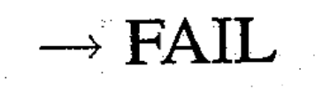
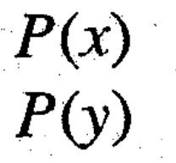

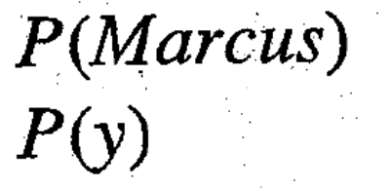

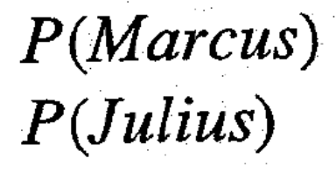
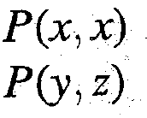
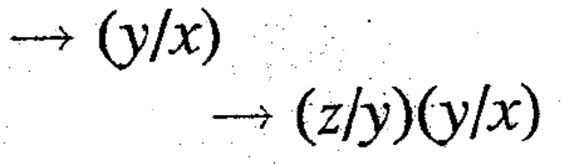
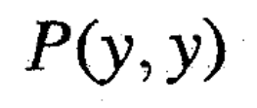
Unification
121

Slide 23
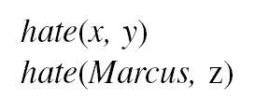
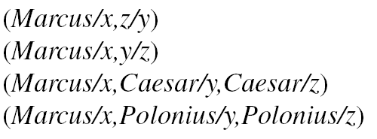
Finding General Substitutions
Given :
We could produce :
122

Slide 24
Algorithm : Unify (L1, L2)
If L1 or L2 are both variables or constants, then:
(a) If L1 and L2 are identical, then return NIL.
(b) Else if L1 is a variable, then if L1 occurs in L2 then return {FAIL}, else return (L2/L1).
(c) Else if L2 is a variable then if L2 occurs in L1 then return {FAIL}, else return (L1/L2).
(d) Else return {FAIL}.
2. If the initial predicate symbols in L1 and L2 are not identical, then return {FAIL).
3. If LI and L2 have a different number of arguments, then return {FAIL}.
4. Set SUBST to NIL.
5. For i ← 1 to number of arguments in L1:
(a) Call Unify with the /th argument of L1 and the ith argument of L2, putting result in S.
(b) If S contains FAIL then return {FAIL}.
(c) If S is not equal to NIL then:
(i) Apply S to the remainder of both L1 and L2.
(ii) SUBST : = APPEND(S, SUBST).
6. Return SUBST.
123

Slide 25

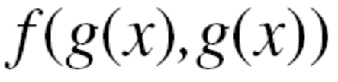
Why Do the Occur Check?
Example :
124

Slide 26
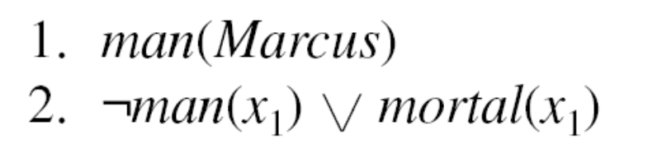
Resolution in Predicate Logic
Example :
Yield the substitution :
Marcus/x₁
So it does not yield the resolvent :
mortal/x₁
It does yield :
mortal(Marcus)
125

Slide 27
Algorithm : Resolution
1. Convert all the statements of F to clause form.
2. Negate P and convert the result to clause form. Add it to the set of clauses obtained in 1.
3. Repeat until either a contradiction is found, no progress can be made, or a predetermined amount of effort has been expended.
Select two clauses. Call these the parent clauses.
Resolve them together. The resolvent will be the disjunction of all the literals of both parent clauses with appropriate substitutions performed and with the following exception: If there is one pair of literals T1 and ¬T2 such that one of the parent clauses contains T2 and the other contains T1 and if T1 and T2 are unifiable, then neither T1 nor T2 should appear in the resolvent. If there is more than one pair of complimentary literals, only one pair shold be omitted from the resolvent.
If the resolvent is the empty clause, then a contradiction has been found. If it is not, then add it to the set of clauses available to the procedure.
126

Slide 28
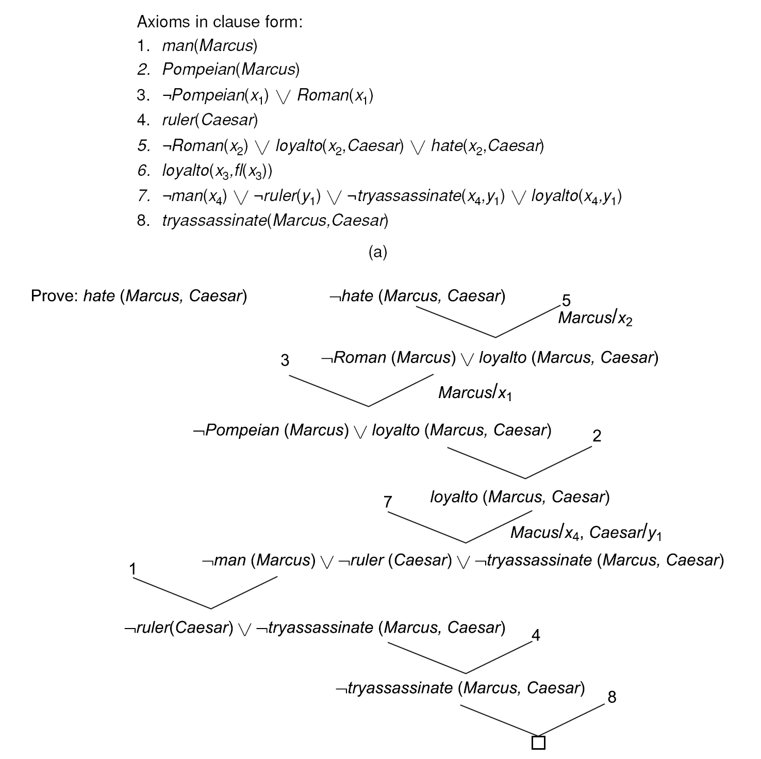
A Resolution Proof
127

Slide 29
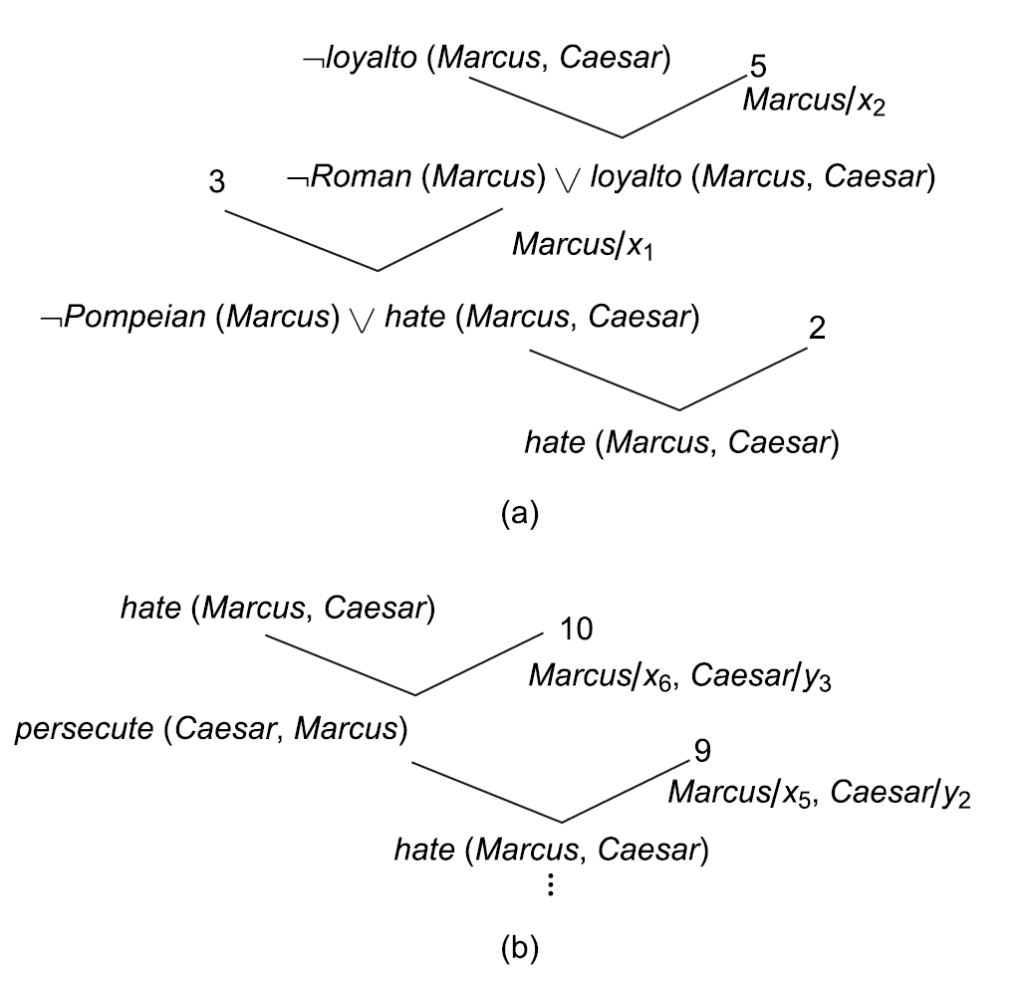
An Unsuccessful Attempt at Resolution
128

Slide 30
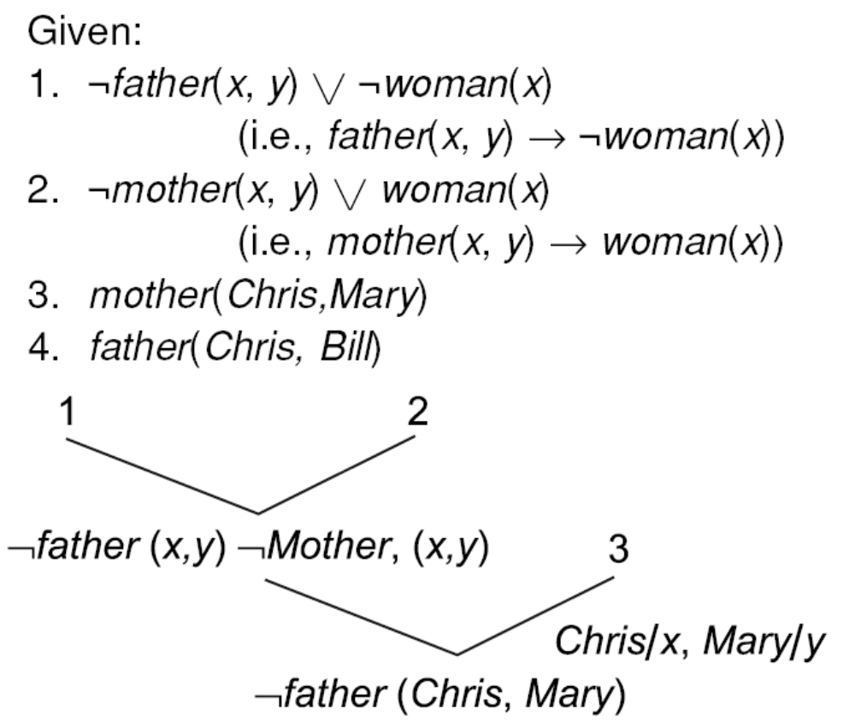
The Need to Standardize Variables
129

Slide 31
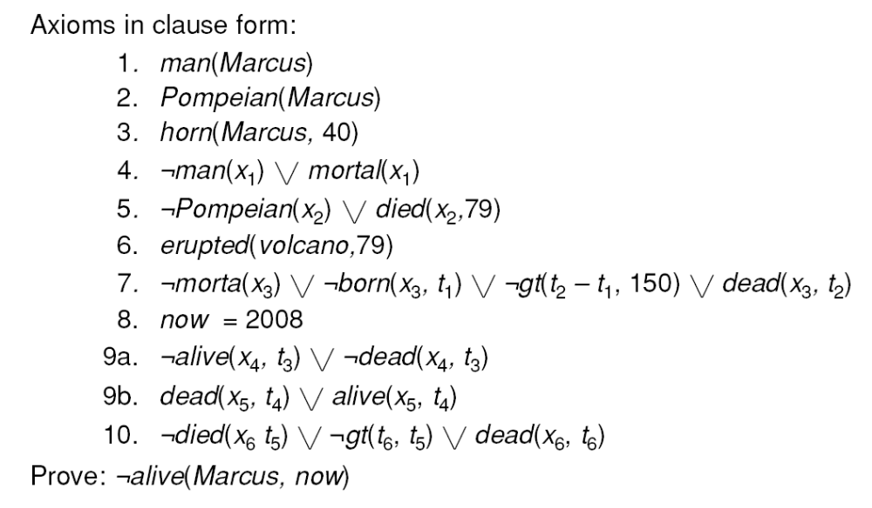
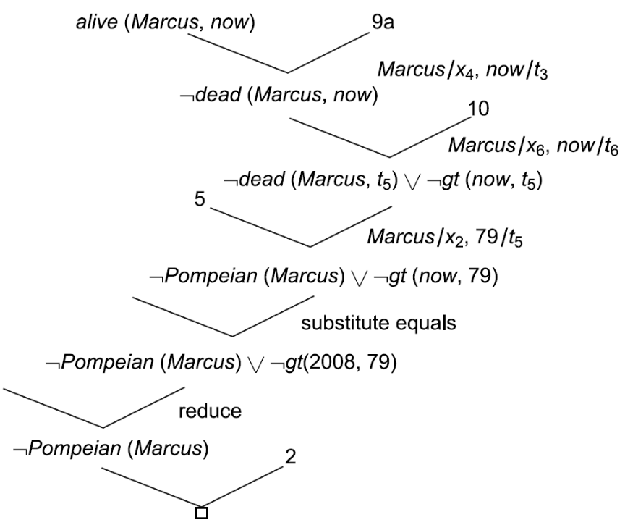
Using Resolution with Equality and Reduce
130

Slide 32
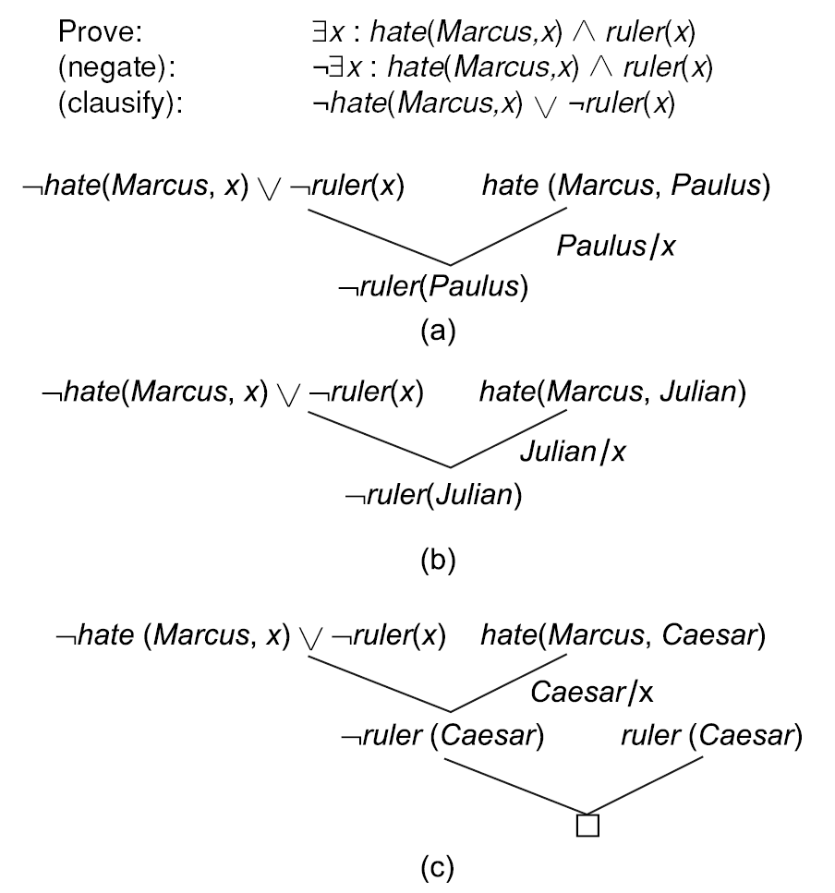
Trying Several Substitutions
131

Slide 33
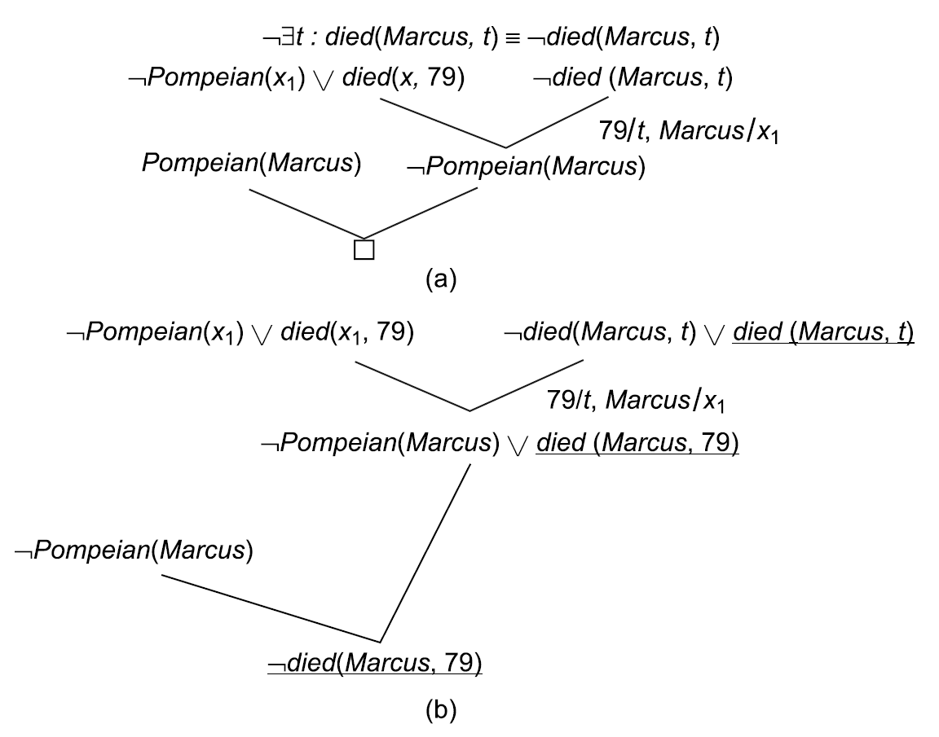
Answers Extraction Using Resolution
132

Slide 34

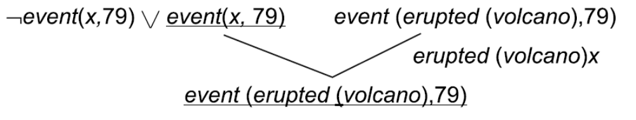
The Need to Change Representations
“What happened in 79 A.D.?”
But we have
erupted(volcano, 79)
133

Slide 35
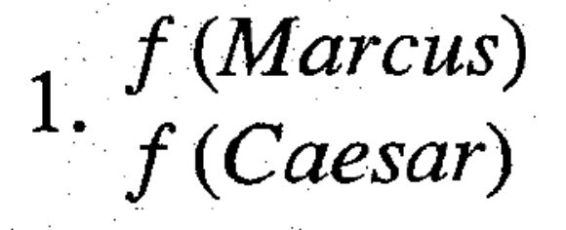
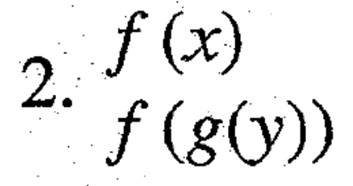
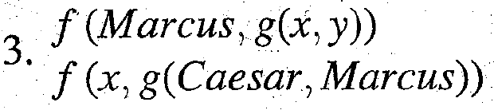
Unification Examples
134

Slide 36
Resolution Example
John likes all kind of food.
Apples are food.
Chicken is food.
Anything anyone eats and isn’t killed by is food.
Bill eats peanuts and is still alive.
Sue eats everything Bill eats.
Prove that John like peanuts using resolution.
What food does sue eat?
135

Slide 37
Resolution Example
The members of the Elm St. Bridge Club are Joe, Sally, Bill and Ellen.
Joe is married to Sally.
Bill is Ellen’s brother.
The spouse of every married person in the club is also in the club.
The last meeting of the club was at Joe’s house.
136

Slide 38
Resolution Example
Steve only likes easy courses.
Science courses are hard.
All the courses in the basket weaving department are easy.
BK301 is a basket weaving course.
137

Slide 39
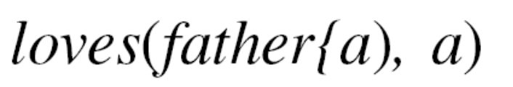
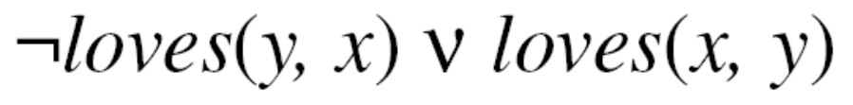
Order of Substitutions
138

Slide 40
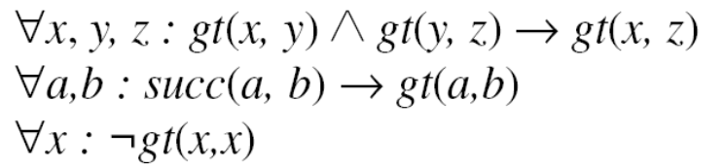

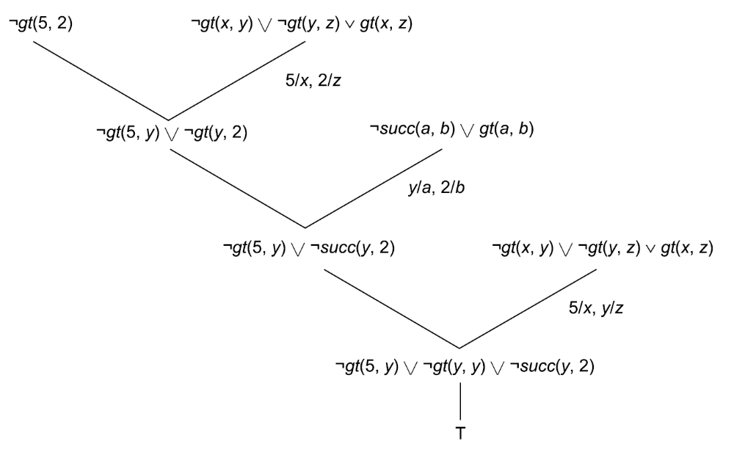
A Problem
Given :
Prove :
What’s wrong with :
139

Slide 41


The Need for the Occur Check
Unify:
140

Slide 42
Summary
In this chapter we showed how predicate logic can be used as the basis of a technique for knowledge representation. We also discussed a problem-solving technique, resolution, that can be applied when knowledge is represented in this way. The resolution procedure is not guaranteed to halt if given a nontheorem to prove. But is it guaranteed to halt and find a contradiction if one exists? This is called the completeness question. In the form in which we have presented the algorithm, the answer to this question is no. Some small changes, usually not implemented in theorem-proving systems, must be made to guarantee completeness. But, from a computational point of view, completeness is not the only important question. Instead, we must ask whether a proof can be found in the limited amount of time that is available. There are two ways to approach achieving this computational goal. The first is to search for good heuristics that can inform a theorem-proving program. Current theorem-proving research attempts to do this. The other approach is to change not the program but the data given to the program. In this approach, we recognize that a knowledge base that is just a list of logical assertions possesses no structure. Suppose an information-bearing structure could be imposed on such a knowledge base. Then that additional information could be used to guide the program that uses the knowledge. Such a program majuiot look a lot like a theorem prover, although it will still be a knowledge-based problem solver. We discuss this idea further in Chapter 9. A second difficulty with the use of theorem proving in AI systems is that there are some kinds of information that are not easily represented in predicate logic. Consider the following examples:
• “It is very hot today.” How can relative degrees of heat be represented?
• “Blond-haired people often have blue eyes.” How can the amount of certainty be represented?
• “If there is no evidence to the contrary, assume that any adult you meet knows how to read.” How can
we represent that one fact should be inferred from the absence of another?
• “It’s better to have more pieces on the board than the opponent has.” How can we represent this kind of
heuristic information?
• “I know Bill thinks the Giants will win, but I think they are going to lose.” How can several different

